Slide 1

ETL Process Manager Financial Services
by Kenny Copas

Slide 2

Professional Summary
Before
Software Engineering (JavaScript, HTML, CSS, Java, Python)
Object-Oriented Programming, Dynamic Programming
Specialization in Data Structures and Algorithms
During
Database Management, Data Processing, Data Analysis
Professional Practices (Version Control, Data Security)
Agile Methodology
Kenny Copas
Data Engineer
PeopleShores PBC
Tampa, FL
linkedin.com/in/kennycopas
After
Courses and Certifications
Machine Learning & Artificial Intelligence
System Architecture
Notes:
2:00
Vscode should be on the main screen
Role, Company
Background (childhood, Software Engineer, DSA)
Current (Learning)
Future (Courses, Certifications, Learning as much as I can)
Problem

Slide 3



Client’s problem, our solution
Problem
Solution
Unnormalized
Not easily human-readable, contains inconsistencies, improperly formatted entries, and no schema.
Projects only ever emerge from a client with a problem.
Data Pipeline
Inaccessible
Rendered inaccessible to anyone non-technical or without the proper permissions or setup.
Command-Line
Interface
Non-visual
Cannot be used to support business claims because it is not visualized.
Analysis &
Visualization
Notes:
Control your speech tempo and affliction
A FINANCIAL SERVICES CLIENT
Client Need
Problems
Non-visual (Need to support a claim)
Lead into Demo

Slide 4
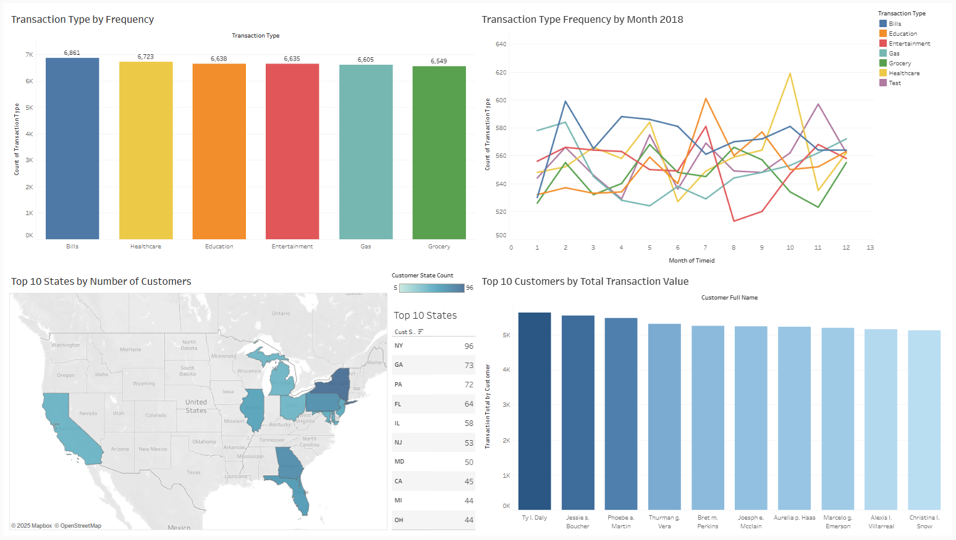
Notes:
Salesman: “Increase advertisement for education around august” Brief, save time for Q&A
Tableau Public Viz Link:
https://public.tableau.com/views/CustomerDataDashboard_17484417707510/CustomerDataDashboard?:language=en-US&:sid=&:redirect=auth&:display_count=n&:origin=viz_share_link

Slide 5




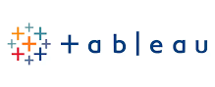
Database Management
Tech Stack
This tech stack was selected to maximize the efficiency, security, and ease-of-use of this project’s system architecture.
Data Processing
Application
Analysis & Visualization
Notes:
4:00
Very brief
Store data
Process Data
Application (Management)
Analysis & Visualization
How these tools interact (workflow)

Slide 6
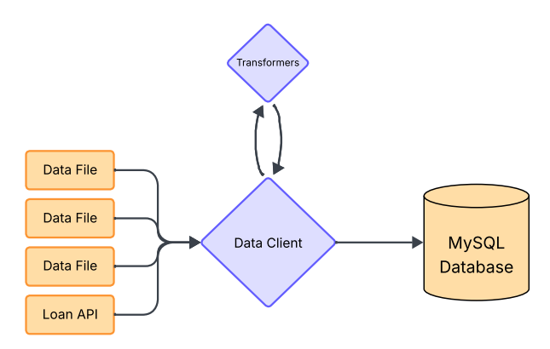
Data Pipeline
The Data Client manages the ETL process and database queries.
The Transformers module contains file-specific transformer functions.
Notes:
Data Client purpose (Modularity)
- Cybersecurity & Cloud
ETL Pipeline
Problem – Solution

Slide 7
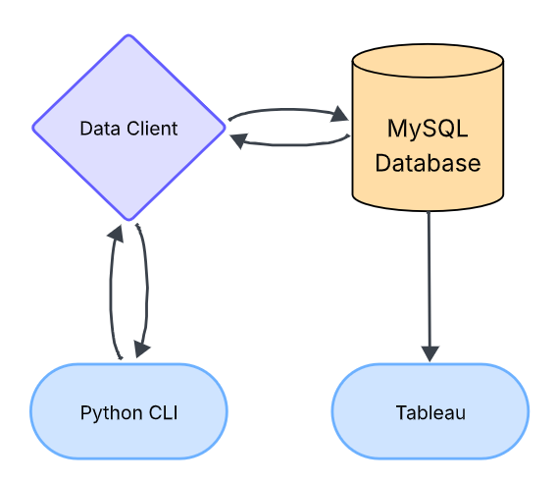
Command- line Interface
Query
The Command-line Interface is the mouthpiece for the Data Client.
The Data Client queries the database for the data the CLI requested.
Data
Request
Response
Notes:
Python CLI
CLI -> Database through Data Client
Problem - Solution

Slide 8




Development Process
Data Migration Setup
Data Pipeline
Command-line Interface
Application Workflow
Notes:
5:00
Showed the overview, now the steps to get there
Quick and Brief
Create Database
Database Connection and Interaction
User-friendly for non-technical
Full Application workflow

Slide 9
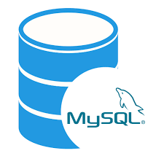
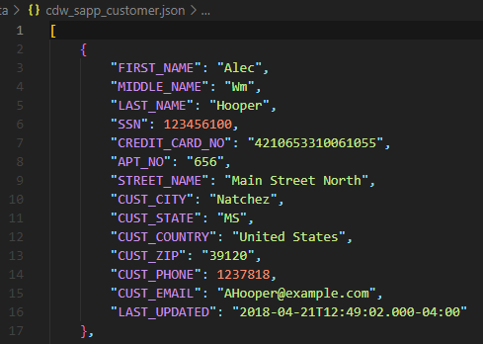
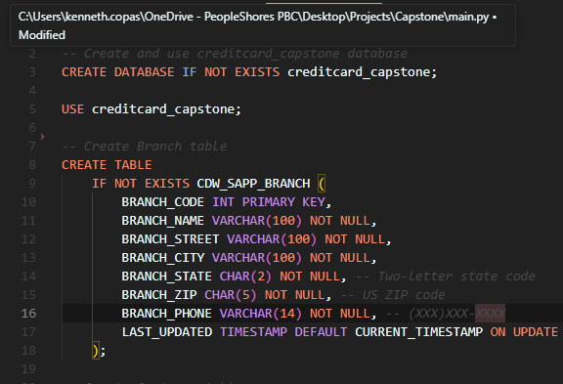
Data Migration Setup
Flat File - Data
MySQL - Script
MySQL Database
MySQL Database?
Unformatted
Unsorted
Cannot be loaded into a database
Initializes Database
Creates Tables
Specifies Schema
Notes:
6:00
Tell them
Control speech tempo and dynamics
Raw Data
Database – Sike, create the database
How to get from point A to point B

Slide 10
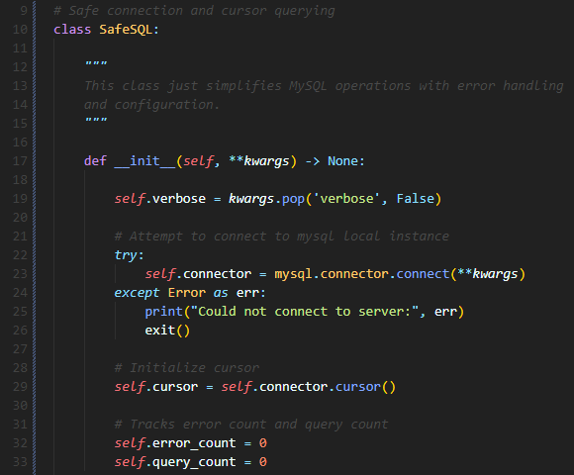
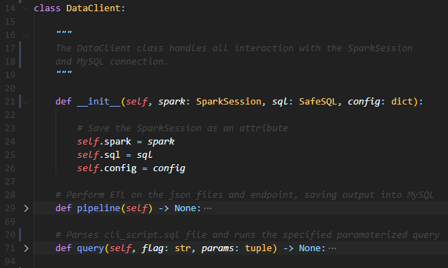
Data Pipeline
SafeSQL - Utility
Data Client - Component
General-Purpose
Database Interaction
Error Handling
Application-Specific
Manages ETL Process
Utilizes MySQL and PySpark connections
Notes:
7:00
Utility – Component interaction
Database connection (error handling)
Data Client uses sql for pipeline
Data is moved, how to access it

Slide 11
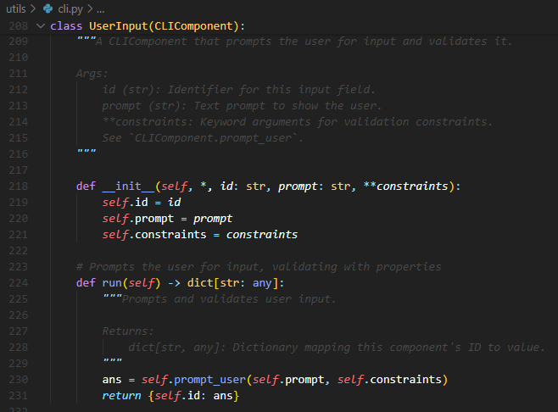
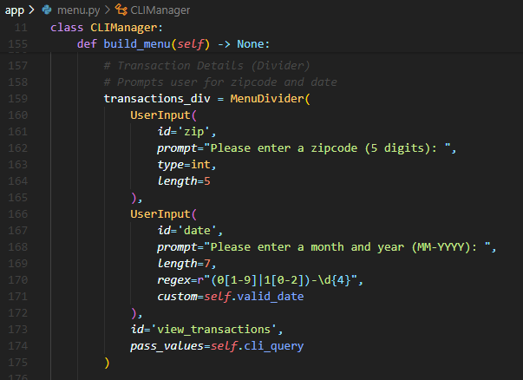
Command-line Interface
CLI Tool-Box - Utility
CLI Manager - Component
General-Purpose
CLI Tool-Box
Simple
Application-Specific
Human-readable
Intuitive
Notes:
8:00
Build a CLI (menu), not without menu components
Use the menu components to make a menu
All components made, how to manage workflow

Slide 12
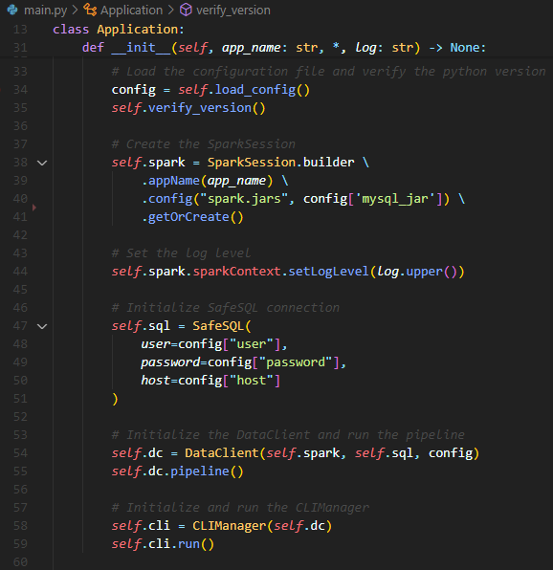
Application Workflow
Manager
Main - Application
The main responsibility of the application is workflow management. The following tasks are completed on application start:
Establishes connections to Apache Spark and MySQL.
Instantiates the Data Client and CLI Manager.
Distributes connections to the respective components where necessary.
Notes:
9:00
Modularity = Brief Application
Application Workflow (In Order)
Lead How was this organized

Slide 13
# Application & Requirements main.py requirements.txt # Components app ├── data_client.py └── menu.py # Configurations config/ └── constants.py # Jar Files jars/ └── mysql-connector-j-9.3.0.jar # Flat file data data/ ├── cdw_sapp_branch.json ├── cdw_sapp_credit_card.json └── cdw_sapp_customer.json | # SQL Scripts sql/ ├── cli_script.sql └── init.sql # Utilities utils/ ├── cli.py ├── transformers.py ├── logging.py └── sql.py # Documentation docs/ ├── CAP350_Project_Specs.pdf ├── diagrams/ └── mapping/
Project Structure
This file structure was chosen to group files by purpose in a concise and meaningful way to maximize readability.
Notes:
10:00
Showed functionality, how did I organize it
Very brief
Save time for conclusion and Q&A
First two problems solved, lastly visualization

Slide 14




Thank you for your time!
Project Recap
github.com/kencopas/Capstone
This project manages an ETL Pipeline using PySpark and MySQL.
The Command Line Interface provides non-technical users interaction with the database.
Tableau is used for Data Analysis and Visualization to tell a story with the data.
Kenny Copas
Data Engineer
PeopleShores PBC
Tampa, FL
linkedin.com/in/kennycopas
linkedin.com/in/kennycopas
Notes:
2:00
Vscode should be on the main screen
Role, Company
Background (childhood, Software Engineer, DSA)
Current (Learning)
Future (Courses, Certifications, Learning as much as I can)
Problem

